Slide 1
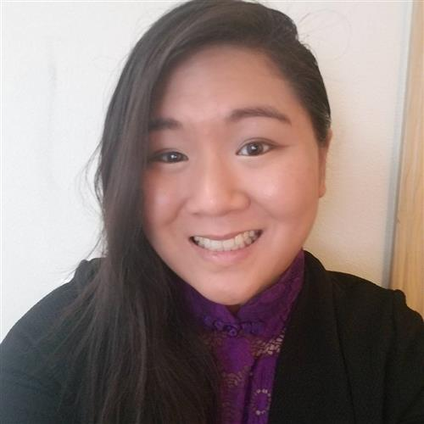
8TH GRADE MATH (PERIODS 1 & 3) & Geometry (PERIOD 2)
Mrs. Knutson
mknutson@everettsd.org (425) 385-7603
♥ Join my Remind class to receive text messages! 8th Grade Parents:: www.remind.com/join/g8knutson
Geometry Parents: www.remind.com/join/geoknutson

Slide 2
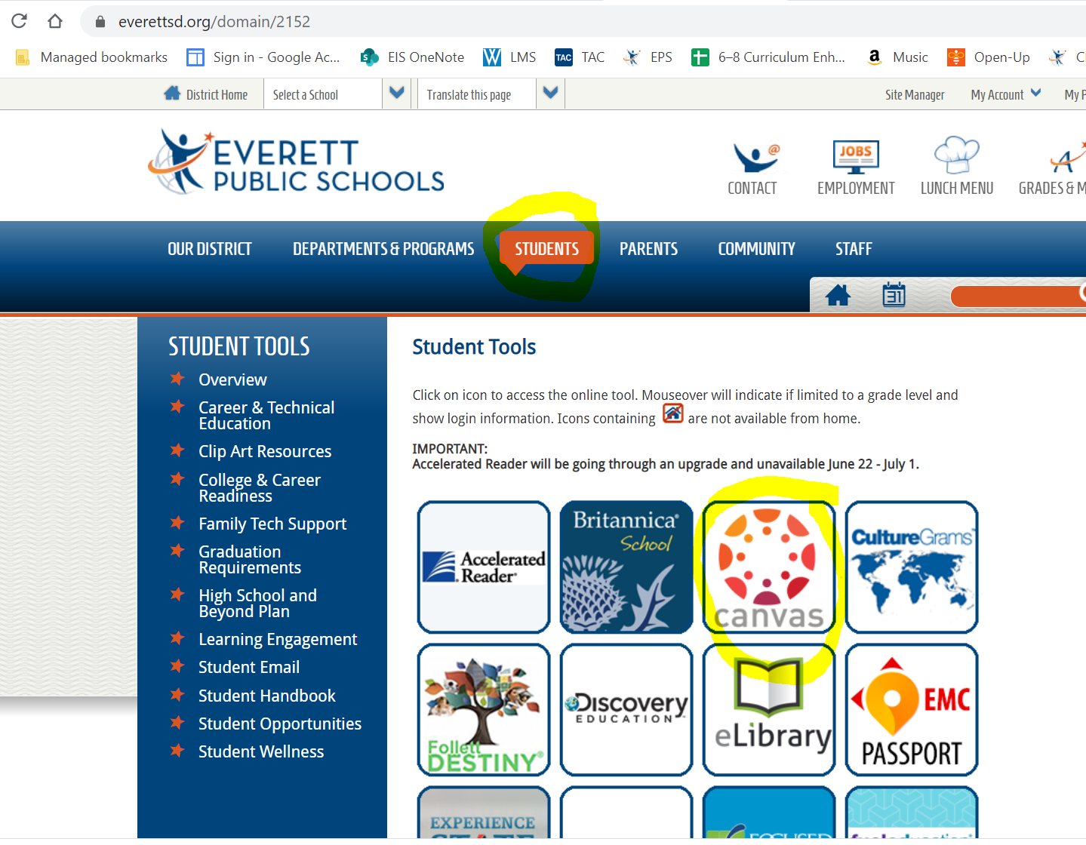
Where can I find everything?
All daily assignments will be accessed through Canvas.
To get to Canvas, go to the District homepage and click on the “Students” tab. You will see the Canvas icon:
Your Canvas Course for Math will look like this🡪

Slide 3
Office Hours
Email: Monday-Friday, 7:30-7:50 a.m. (While you are encouraged to email me at any time, this will be dedicated time when you can expect a quick reply from me.)
Phone: Tuesday and Thursday, 7:30-7:50 a.m. & 11:00-11:30 a.m.
Zoom: Monday-Thursday, 7:30-7:50 a.m. & 11:00-11:30 a.m. by appointment only. (Students should email me to make arrangements.)

Slide 4
Daily Schedule
Each period will begin with a Zoom.
(Approximately 30 minutes. Attendance is mandatory.)
Students will then have individual work time*. (All assignments will be listed and hyperlinked in our Canvas course.)
Each period will conclude with an option Zoom. (The last 20 minutes of each period will be reserved as a drop-in Zoom session for students who have questions. Attendance is optional.)
*All daily work is designed to be completed within the timeframe of a class period. Should students need additional time to complete assignments, they may submit work by 7:30 a.m. the following school day without penalty.

Slide 5
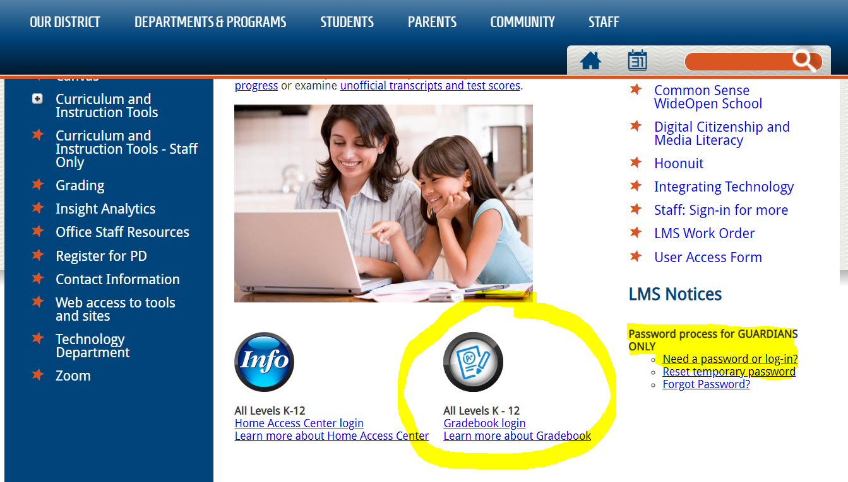
Grades
Grades will be maintained daily in the online gradebook.
To access this program, select “Grades & More” from the top righthand corner of the District Website homepage.
Parents: Need to create an account? CLICK HERE
The Eisenhower Math Department grades on a percentage scale. Grades in math are weighted as follows: 40% - Independent Work, 60% - Assessments (Quizzes and Unit Tests).

Slide 6
Zoom Guidelines
Do not
Turn your video on or use a profile picture of yourself.
Sign in using your REAL first and last name.
Stay muted until you are called on to share out.
Be an active listener and participant.
Be respectful to teachers and peers.
Come prepared with materials.
Be a good digital citizen.
Be on time!

Slide 7
Conferences
Got questions? I’d love to help!
Choose the session that works best for you!
https://everettsd.zoom.us/j/94535847303
September 9, 10, or 11:
1:00 – 1:20 p.m. 1:30 – 1:50 p.m. 2:00 – 2:20 p.m. 2:30 – 2:50 p.m.

